Slide 1
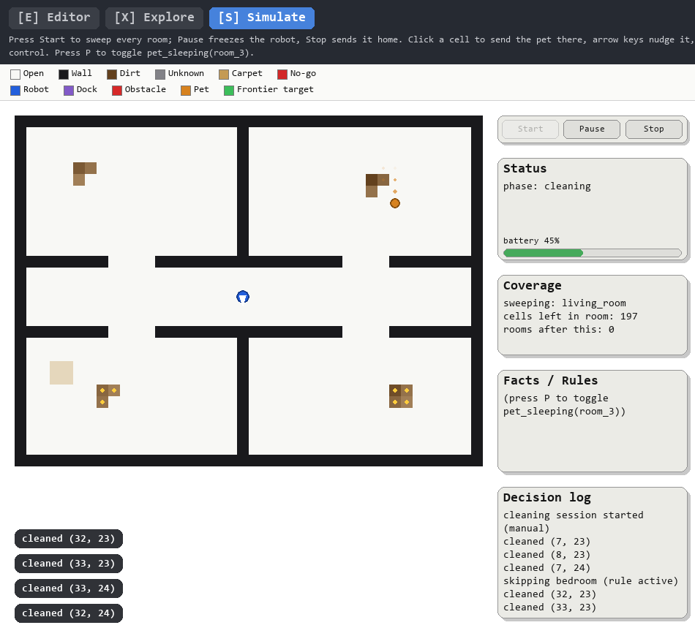
PROJECT REVIEW – I
LOGIClean
An Autonomous Cleaning Robot Using Classical AI
40 × 30 grid · five AI techniques · seven floor plans
A robot that maps an unknown house with limited sensing, then cleans it one room at a time using search, rules and constraint solving.
BY
Jhasmitha D – 2116230701216
Keerthi Priya T – 2116230701258
Foundations of Artificial Intelligence
The application in Simulate mode: the robot sweeping the default house

Slide 2
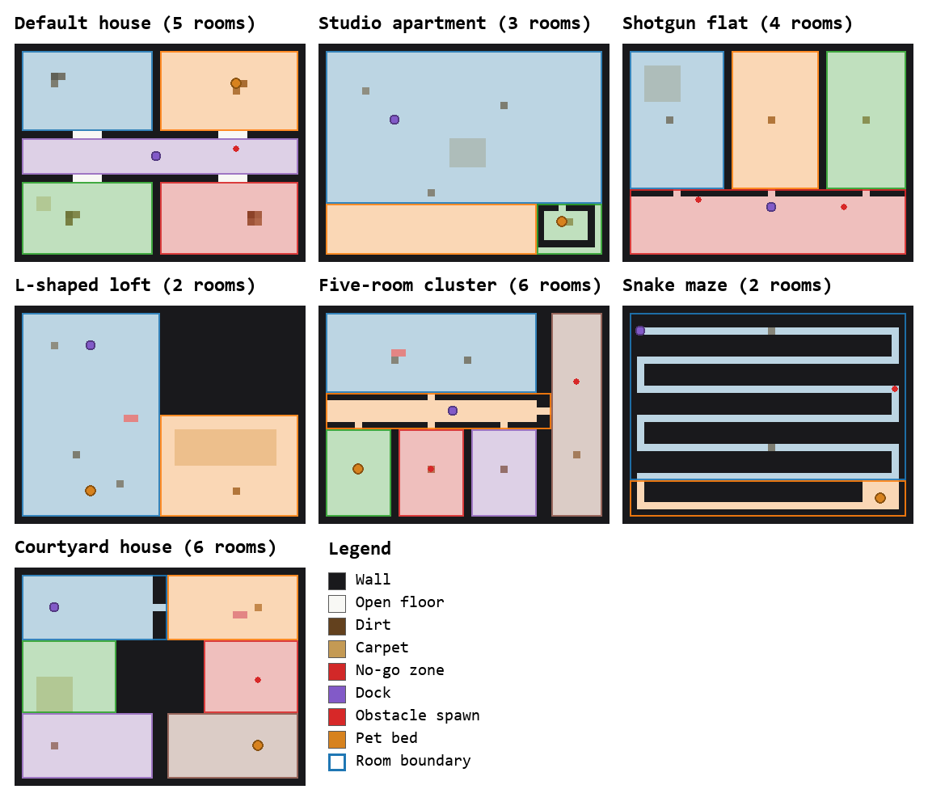
Project Overview
01 · ABSTRACT
What the robot is, and what the AI has to do
THE ROBOT
LOGIClean is a simulated cleaning robot built only from classical AI. It starts with no map and senses just the four cells next to it, builds a belief map, and cleans each room completely before moving on. There is no machine learning anywhere in the system.
KEY CONCEPTS
Belief map · A* search · Frontier exploration · Forward chaining · Constraint satisfaction · Coverage planning
AT A GLANCE
7 floor plans, each fully mapped
Every dirty cell cleaned, no room revisited
173 automated tests, all passing
The seven floor plans the robot was tested on

Slide 3
From a Blank Map to a Clean House
02 · PROBLEM STATEMENT
Why a cleaning robot is an AI problem
PROBLEM
The robot starts with no knowledge of the house layout.
It senses only the four cells next to it, so the world is only partly observable.
Every room has to be cleaned completely, one room at a time, in a valid order.
Household rules apply. The room where the pet is sleeping is skipped.
People, pets and obstacles move, so plans have to be revised during a run.
AI CHALLENGE
Sense the neighbouring cells
Update the belief map
Plan a route with A*
Apply rules and order the rooms
Move, clean and repeat
PROBLEM STATEMENT Design a simulated cleaning robot that explores an unknown floor plan, cleans it room by room, obeys household rules and avoids moving hazards, using only classical, non-learning AI.

Slide 4
Existing Foundations for the AI Techniques
03 · LITERATURE SURVEY
Established work that LOGIClean combines
Work / Source | Technique | Key Finding | Project Relevance
Hart, Nilsson & Raphael (1968) | A* search | An admissible heuristic gives optimal paths efficiently. | All route planning
Yamauchi (1997) | Frontier exploration | Travelling to the nearest frontier maps an unknown space. | Mapping the house
Choset & Pignon (1998) | Boustrophedon coverage | Back-and-forth sweeps cover free space completely. | Room-by-room cleaning
Mackworth (1977) | AC-3 + backtracking | Arc consistency prunes impossible values before search. | Room visiting order
Kowalski (1979) | Forward chaining | Rules applied to known facts derive new conclusions. | Skip rule for the pet
LaValle (2006) | Replanning | Plan again from the current state when the world changes. | Moving obstacles and pet
Each technique is well established on its own. The project’s contribution is putting them together in one small robot whose every decision can be traced.

Slide 5
Where the Proposed Work Is Positioned
04 · RESEARCH GAP
Reading across cleaning robots and AI teaching examples
EXISTING CLEANING ROBOTS
Commercial robot vacuums map and clean effectively.
Their decision logic is usually proprietary or learned, so individual decisions are hard to trace or explain.
EXISTING AI EXAMPLES
Search, constraint satisfaction and logic are normally shown on separate toy problems.
Few examples show them cooperating inside one agent that has to act in a world.
IDENTIFIED GAP
One transparent system that combines:
Belief map kept apart from the ground truth
A* search and frontier exploration
Rules and CSP room ordering
Complete room-by-room coverage
Prediction and replanning around hazards
RESEARCH GAP STATEMENT
There is scope for a small, inspectable cleaning robot in which every decision comes from a named classical algorithm, and in which the techniques are shown working together on floor plans of different structure.

Slide 6
What the Project Aims to Achieve
05 · RESEARCH OBJECTIVE
PRIMARY OBJECTIVE
Develop a simulated cleaning robot that maps an unknown floor plan, orders the rooms with a constraint solver and cleans each room completely using classical AI techniques.
01 Belief map
Keep the robot’s belief separate from the true map, so it plans only on what it has sensed.
02 Exploration
Map the house with frontier exploration, travelling with A* over cells it has already seen.
03 Rules
Apply household rules by forward chaining, such as skipping the room of a sleeping pet.
04 Room order
Order the rooms as a constraint problem, solved with AC-3 and backtracking.
05 Coverage
Sweep every room completely, one room at a time, so dirt is cleaned without being located first.
06 Avoidance
Predict where moving hazards will be and replan the route around them.

Slide 7
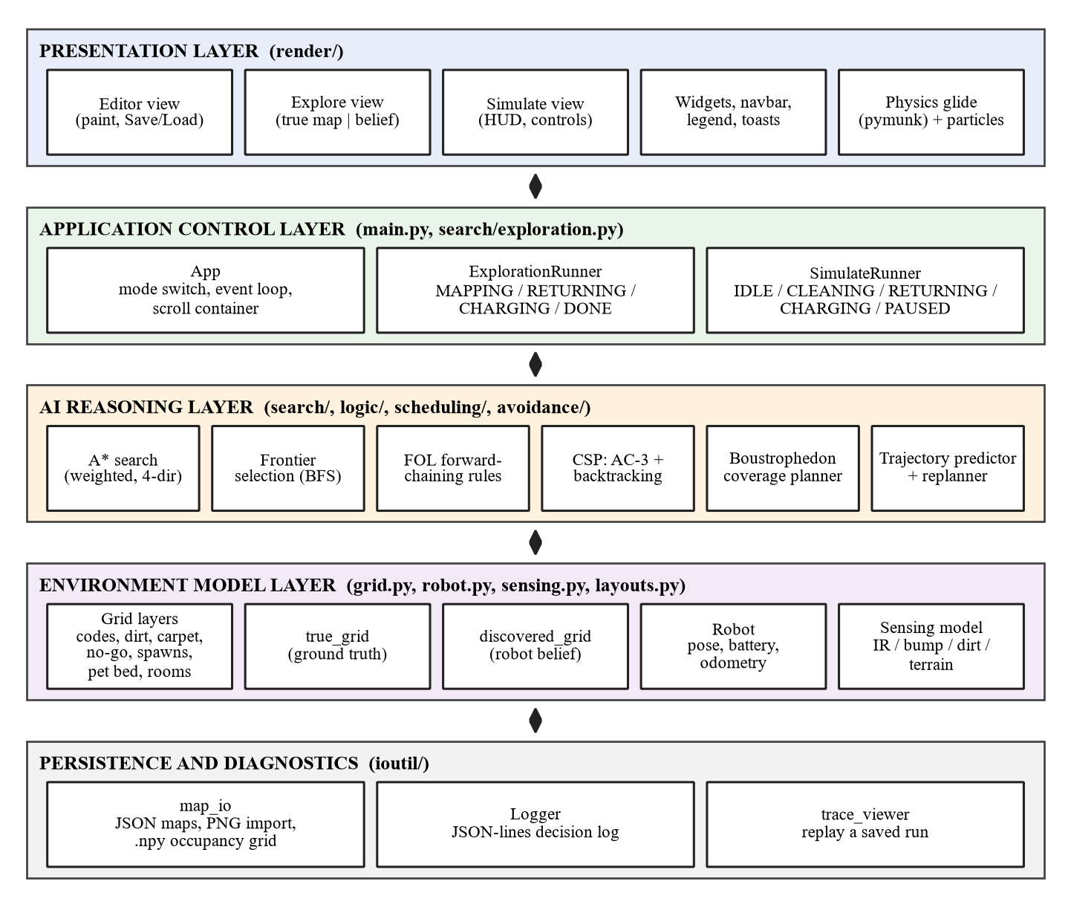
Architecture, Technology Stack & Algorithm
06 · PROPOSED WORK
Five layers; each one depends only on the layers below it
TECH STACK
Python 3.11 · Pygame · NumPy · pymunk · pytest
Maps are saved as JSON and every decision is logged as JSON lines.
ALGORITHM
A* search with a terrain-aware cost
Frontier exploration over the belief map
Forward chaining for household rules
AC-3 and backtracking for the room order
Boustrophedon sweep, one room at a time
Trajectory prediction with replanning
Future option: noisy sensing with a probabilistic occupancy grid.

Slide 8
Software, System Requirements & Modules
07 · IMPLEMENTATION
What is needed to build and run the system
SOFTWARE REQUIREMENTS
Python 3.11
Pygame 2.6 for display and input
NumPy for the grid layers
pymunk for the visual glide only
pytest for the automated tests
Windows, Linux or macOS
SYSTEM REQUIREMENTS
MINIMUM
Dual-core processor
4 GB RAM
500 MB free storage
1280 × 720 display
Keyboard and mouse
Recommended: 8 GB RAM and a modern processor.
IMPLEMENTATION MODULES
Environment and sensing
Search and exploration
Logical reasoning
Constraint satisfaction
Coverage and controller
Obstacle avoidance

Slide 9
Key Sources Used for Project Framing
REFERENCES
S. Russell and P. Norvig, Artificial Intelligence: A Modern Approach, 4th ed., Pearson, 2021.
P. E. Hart, N. J. Nilsson and B. Raphael, “A Formal Basis for the Heuristic Determination of Minimum Cost Paths,” IEEE Transactions on SSC, 1968.
B. Yamauchi, “A Frontier-Based Approach for Autonomous Exploration,” IEEE CIRA, 1997.
H. Choset and P. Pignon, “Coverage Path Planning: The Boustrophedon Cellular Decomposition,” Field and Service Robotics, 1998.
A. K. Mackworth, “Consistency in Networks of Relations,” Artificial Intelligence, 1977.
R. Kowalski, Logic for Problem Solving, North-Holland, 1979.
S. M. LaValle, Planning Algorithms, Cambridge University Press, 2006.
Thank You
Questions & Discussion

